Slide 1
5. Process Synchronization
Course Exercise in Operating System

Slide 2
Contents
Critical Section
Semaphore
Monitor
Thread Synchronization in Nachos

Slide 3
Critical Section
Sharing in Concurrent Processes
  address space shared by concurrent threads in a process
  shared memory can be arranged and shared by UNIX processes although they do not share address spaces
Problems with Shared Variables
  possible context switch by time-out at end of every instruction
  Data may become inconsistent if shared variables are updated without proper control.

Slide 4
Critical Section
example: two threads update a shared variable counter.
    Thread A Thread B
    { {
      . . . . . .
      counter++; --counter;
      . . . . . .
    } }
the machine code translated by gcc for MIPS computer
    Thread A Thread B
    . . . . . .
    lw $2,counter lw $4,counter
    addu $3,$2,1 addu $5,$4,-1
    sw $3,counter sw $5,counter
    . . . . . .

Slide 5
Critical Section
With counter=5 initially
    lw $2,counter
    addu $3,$2,1
    lw $4,counter
    addu $5,$4,-1
    sw $3,counter counter=6
    sw $5,counter counter=4
the instructions of two threads could interleaved in certain ways.

Slide 6
Critical Section
Critical Section
Code section to be executed by at most one process at a time
A high-level language concept and structure to
  enable one thread to execute the code section
  while blocking other threads trying to execute it
Controlled by
  entry code for entering
  exit code after exiting

Slide 7
Critical Section
Common model of critical section
  repeat
  critical section
  remaining section
  until false;
The key problem is how to design the code in boxes the “Entry Section” and ”Exit Section”
Entry Section
Exit Section

Slide 8
Critical Section
Hardware Solution with Test-and-Set Instruction
Test-and-Set instruction: an atomic instruction to do
  1. read and return the Boolean value of the lock
  2. set the value of the lock to be true
Critical Section
    repeat
      while Test-and-Set(Lock) do no-op;
      critical section;
      Lock = false;
      remaining section;
    until false
Problem
  Rely on busy-waiting, which wastes CPU cycles
  Complicated for application programmers to use

Slide 9
Contents
Critical Section
Semaphore
Monitor
Thread Synchronization in Nachos

Slide 10
Semaphore
Semaphore is a special data type for process synchronization in operating systems.
  It normally has two private data members
    an integer s to represent the value of the semaphore
    a process queue to accommodate processes or threads blocked on the semaphore.
  methods (operations)
    P() (Wait() in the text)
    V() (Signal() in the text)
  Both P() and V() methods are atomic.
  Interrupt is disabled during the execution of each method(…)

Slide 11
Semaphore
Semaphore Algorithm 1 (used in the textbook)
P()
  s = s - 1;
  if (s < 0)
  block current process and put it in the queue;
V()
  s = s + 1;
  if (s<= 0)
  remove a process from the queue and wake it up;

Slide 12
Semaphore
Semaphore Algorithm 2 (used in Nachos)
P()
  while (s = 0)
  block current process and put it in the queue;
  s = s - 1;
V()
  if (the queue is non-empty)
  remove a process from the queue and wake it up;
  s = s + 1;

Slide 13
Semaphore
Bounded Buffer Problem- A classical problem in operating systems and networking
  Producer processes put data items into the buffer
  Consumer processes get the data items from the buffer
  Shared buffer with n slots to store at most n items
  Variable in points to the first empty slot in the buffer
  Variable out points to the first valid item in the buffer
Producer Process
repeat
  produce an item in nextp;
  entry synchronization;
    buffer[in] = nextp;
    in = in + 1 mod n;
  exit synchronization;
  remaining section;
until false
Consumer Process
repeat
  entry synchronization;
    nextc = buffer[out];
    out = out + 1 mod n;
  exit synchronization;
    consume the item nextc;
    remaining section;
until false

Slide 14
Semaphore
Synchronization Required
critical section for operations on shared buffer and its pointers
consumer should be blocked when buffer is empty
producer should be blocked when buffer is full
Critical Section
  use a semaphore for the critical sections in both producer and consumer
Semaphore *mutex = new Semaphore(''mutex'', 1);

Slide 15
Semaphore
Emptiness Control
  Producers reduce the emptiness
  Consumers increase the emptiness
  There are n empty slots initially
  Use a semaphore to block producers when emptiness is reduced to zero
Semaphore *nEmpty = new Semaphore(''nEmtpy'', n);
Fullness Control
  Producers increase the fullness
  Consumers reduce the fullness
  There are 0 full slots initially
  Use a semaphore to block consumers when fullness is reduced to zero
Semaphore *nFull = new Semaphore(''nFull'', 0);

Slide 16
Semaphore
Producer Process
repeat
  produce an item in nextp;
  nEmpty->P();
  mutex->P();
  buffer[in] = nextp;
  in = in + 1 mod n;
  mutex->V();
  nFull->V();
  remaining section;
until false
Consumer Process
repeat
  nFull->P();
  mutex->P();
  nextc = buffer[out];
  out = out + 1 mod n;
  mutex->V();
  nEmpty->V();
  consume the item nextc;
  remaining section;
until false

Slide 17
Semaphore
The order of semaphore operations is important.
  What may happen to the following code?
Producer Process
repeat
  produce an item in nextp;
  mutex->P();
  nEmpty->P();
  buffer[in] = nextp;
  in = in + 1 mod n;
  nFull->V();
  mutex->V();
  remaining section;
until false
Consumer Process
repeat
  mutex->P();
  nFull->P();
  nextc = buffer[out];
  out = out + 1 mod n;
  nEmpty->V();
  mutex->V();
  consume the item nextc;
  remaining section;
until false
应先执行对资源信号量的P操作，然后再执行对互斥信号量的P操作

Slide 18
Semaphore
Dining Philosopher Problem
a round table with N dining philosophers
one chop-stick between neighboring philosophers
philosophers' process
    for (;;) {
    thinking;
    pick up both left and right chopstick;
    eating;
    put down both left and right chopstick;
    }
Solution using semaphores
one semaphore with value 1 for each chop-stick
use P() for action of picking up (acquire) chop-stick
use V() for action of putting down (release) chop-stick

Slide 19
Semaphore
Philosopher i
    While (true) {
    P ( chopstick[i] );
    P( chopstick[ (i + 1) % 5] );
    // eat
    V ( chopstick[i] );
    V (chopstick[ (i + 1) % 5] );
    // think
    }
Possible Deadlock！

Slide 20
Contents
Critical Section
Semaphore
Monitor
Thread Synchronization in Nachos

Slide 21
Monitor
Monitor
  A special abstract data type whose function (method) invocations are guaranteed to be mutually exclusive.
  With an implicit lock (semaphore) to control mutual exclusion

Slide 22
Monitor
Condition Variable
  A monitor won't be useful without condition variables
  Represent the condition for which several concurrent processes may be waiting
  two operations (methods)
    wait() : cause the calling process (thread) to block (wait) at this condition variable
    signal() : if there is a process (thread) blocking (waiting) at this condition variable, wake it up; otherwise do nothing

Slide 23
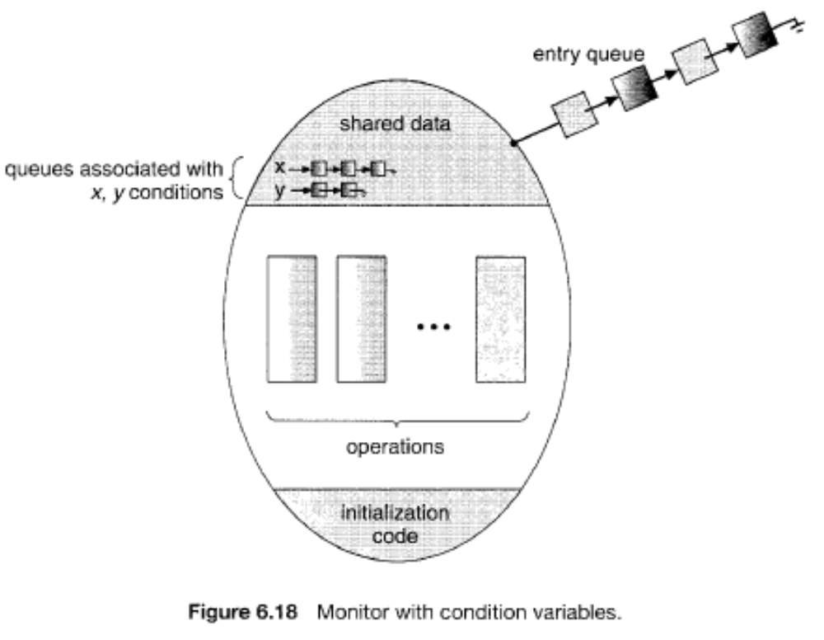
Monitor

Slide 24
Monitor
Two styles of Monitor
  Consider that process P calls signal() of a condition variable and wakes up process Q.
  Hoare style
    Q continues immediately and P suspends itself
    advantage: condition is guaranteed to be satisfied when Q resumes, so can use if to check the condition (does not need to re-check the condition)
    disadvantage: high context-switch overhead
  Mesa style
    P continues, and Q is moved to queue and continues later
    disadvantage: condition may not be satisfied when Q resumes, so need while loop to check the condition again
    advantage: more efficient

Slide 25
Contents
Critical Section
Semaphore
Monitor
Thread Synchronization in Nachos

Slide 26
Thread Synchronization in Nachos
Files:
  ../threads/synch.h
  ../threads/synch.cc
Semaphore Class
  private member
    private:
    char* name; // useful for debugging
    int value; // semaphore value, always >= 0
    List *queue; // threads waiting in P() for the value to be > 0
  Functions
    void P(); // these are the only operations on a semaphore
  void V(); // they are both *atomic*

Slide 27
Thread Synchronization in Nachos
Semaphore Class (continued)
  Constructor
  Semaphore::Semaphore(char* debugName, int initialValue)
  {
    name = debugName;
    value = initialValue;
    queue = new List;
  }

Slide 28
Thread Synchronization in Nachos
Semaphore Class (continued)
  P( )
  void Semaphore::P()
  {
    IntStatus oldLevel = interrupt->SetLevel(IntOff); // disable interrupts
    while (value == 0) { // semaphore not available
      queue->Append((void *)currentThread); // so go to sleep
      currentThread->Sleep();
    }
    value--; // semaphore available,
    // consume its value
    (void) interrupt->SetLevel(oldLevel); // re-enable interrupts
  }

Slide 29
Thread Synchronization in Nachos
Semaphore Class (continued)
  V( )
  void Semaphore::V()
  {
    Thread *thread;
    IntStatus oldLevel = interrupt->SetLevel(IntOff);
    thread = (Thread *)queue->Remove();
    if (thread != NULL)
      // make thread ready, consuming the V immediately
      scheduler->ReadyToRun(thread);
    value++;
    (void) interrupt->SetLevel(oldLevel);
  }

Slide 30
Thread Synchronization in Nachos
Lock Class
  binary semaphore with checking of the ownership of the lock
  class Lock {
  public:
    Lock(char* debugName); // initialize lock to be FREE
    ~Lock(); // deallocate lock
    char* getName() { return name; } // debugging assist
    void Acquire(); // these are the only operations on a lock
    void Release(); // they are both *atomic*
    bool isHeldByCurrentThread(); // true if the current thread
  // holds this lock. Useful for
  // checking in Release, and in
  // Condition variable ops below.
  private:
    char* name; // for debugging
    Thread *owner; // remember who acquired the lock
    Semaphore *lock; // use semaphore for the actual lock
  };

Slide 31
Thread Synchronization in Nachos
Lock Class (continued)
  constructor
  Lock::Lock(char* debugName)
  {
    name = debugName;
    owner = NULL;
    lock = new Semaphore(name,1);
  }
  function Acquire()
  void Lock::Acquire()
  {
    IntStatus oldLevel = interrupt->SetLevel(IntOff); // disable interrupts
    lock->P(); // procure the semaphore
    owner = currentThread; // record the new owner of the lock
    (void) interrupt->SetLevel(oldLevel); // re-enable interrupts
  }

Slide 32
Thread Synchronization in Nachos
Lock Class(continued)
  function Release()
  void Lock::Release()
  {
    IntStatus oldLevel = interrupt->SetLevel(IntOff); // disable interrupts
    // Ensure:
    // a) lock is BUSY
    // b) this thread is the same one that acquired it.
    ASSERT(currentThread == owner);
    owner = NULL; // clear the owner
    lock->V(); // vanquish the semaphore
    (void) interrupt->SetLevel(oldLevel);
  }

Slide 33
Thread Synchronization in Nachos
Condition Class
  Mesa Style Condition Variable
  class Condition {
  public:
    Condition(char* debugName); // initialize condition to
    // "no one waiting"
    ~Condition(); // deallocate the condition
    char* getName() { return (name); }
    void Wait(Lock *conditionLock); // these are the 3 operations on
    // condition variables; releasing the
    // lock and going to sleep are
    // *atomic* in Wait()
    void Signal(Lock *conditionLock); // conditionLock must be held by
    void Broadcast(Lock *conditionLock); // the currentThread for all of
    // these operations
  private:
    char* name;
    List* queue; // threads waiting on the condition
    Lock* lock; // debugging aid: used to check correctness of
    // arguments to Wait, Signal and Broacast
  };

Slide 34
Thread Synchronization in Nachos
Condition Class (continued)
  function Wait(Lock* conditionLock)
  void Condition::Wait(Lock* conditionLock)
  {
    IntStatus oldLevel = interrupt->SetLevel(IntOff);
    ASSERT(conditionLock->isHeldByCurrentThread()); // check pre-condition
    if(queue->IsEmpty()) {
    lock = conditionLock; // helps to enforce pre-condition
    }
    ASSERT(lock == conditionLock); // another pre-condition
    queue->Append(currentThread); // add this thread to the waiting list
    conditionLock->Release(); // release the lock
    currentThread->Sleep(); // goto sleep
    conditionLock->Acquire(); // awaken: re-acquire the lock
    (void) interrupt->SetLevel(oldLevel);
  }

Slide 35
Thread Synchronization in Nachos
Condition Class (continued)
  function Signal(Lock* conditionLock)
  void Condition::Signal(Lock* conditionLock)
  {
    Thread *nextThread;
    IntStatus oldLevel = interrupt->SetLevel(IntOff);
    ASSERT(conditionLock->isHeldByCurrentThread());
    if(!queue->IsEmpty()) {
      ASSERT(lock == conditionLock);
      nextThread = (Thread *)queue->Remove();
      scheduler->ReadyToRun(nextThread); // wake up the thread
    }
    (void) interrupt->SetLevel(oldLevel);
  }

Slide 36
Thread Synchronization in Nachos
Condition Class (continued)
  function Broadcast(Lock* conditionLock)
  void Condition::Broadcast(Lock* conditionLock)
  {
    Thread *nextThread;
    IntStatus oldLevel = interrupt->SetLevel(IntOff);
    ASSERT(conditionLock->isHeldByCurrentThread());
    if(!queue->IsEmpty()) {
      ASSERT(lock == conditionLock);
      while(nextThread = (Thread *)queue->Remove()) {
      scheduler->ReadyToRun(nextThread); // wake up the thread
      }
    }
    (void) interrupt->SetLevel(oldLevel);
  }

Slide 37
Thread Synchronization in Nachos
Use of Monitors (example)
Files
  ..threads/synchlist.h
  .. threads/synchlist.cc
A synchronized linked list class in Nachos called SynchList to be accessed by multiple threads.
actually implemented as a monitor with mesa style condition variables.

Slide 38
Thread Synchronization in Nachos
SynchList Class
class SynchList {
public:
  SynchList(); // initialize a synchronized list
  ˜SynchList(); // de-allocate a synchronized list
  void Append(void *item); // append item to the end of the list,
  // and wake up any thread waiting in remove
  void *Remove(); // remove the first item from the front of
  // the list, waiting if the list is empty
  void Mapcar(VoidFunctionPtr func); // apply function to every item in the list
private:
  List *list; // the unsynchronized list
  Lock *lock; // enforce mutual exclusive access to the list
  Condition *listEmpty; // wait in Remove if the list is empty
};

Slide 39
Thread Synchronization in Nachos
SynchList Class (continued)
  Function Remove()
  void *
  SynchList::Remove()
  {
    void *item;
    lock->Acquire(); // enforce mutual exclusion
    while (list->IsEmpty())
    listEmpty->Wait(lock); // wait until list isn’t empty
    item = list->Remove();
    ASSERT(item != NULL);
    lock->Release();
    return item;
  }

Slide 40
Thread Synchronization in Nachos
SynchList Class (continued)
  Function Append(void *item)
  void
  SynchList::Append(void *item)
  {
    lock->Acquire(); // enforce mutual exclusive // access to the list
    list->Append(item);
    listEmpty->Signal(lock); // wake up a waiter, if any
    lock->Release();
  }

Slide 41
实验中存在的问题
定位到其它文件中的函数
    list filename:linenum
    list classname::funcname
    break …
查看函数地址
    break functionname
      函数第一条指令的地址
查看对象地址、内容
    print &variable
    print pvariable
    print *pvariable
查看汇编指令
    display /i $pc
    ni

Slide 42
提交报告格式
文件命名方式：
  学号_姓名_实验号.DOC
  如：xxxxxxxxxxx_xxx_实验1.doc
报告内容
  实验目标
  实验环境
  关键代码注释
  调试记录
  运行结果分析等

